Slide 1

ConnectIU
Bring IU community back together
Created by Kaisen Ye

Slide 2
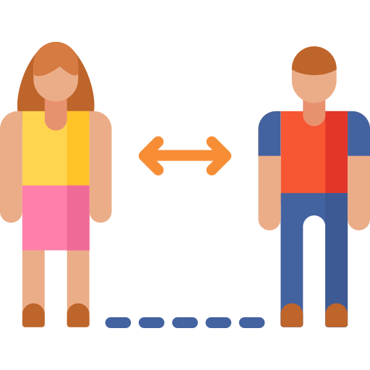
“Covid pandemic has forced us into social distancing and turned everything into remote”
Problem
“After back to campus, many students still feel their social lives haven’t resumed and are disconnected with others"
Social Distancing

Slide 3

Problem
When?
Where?
How?

Slide 4
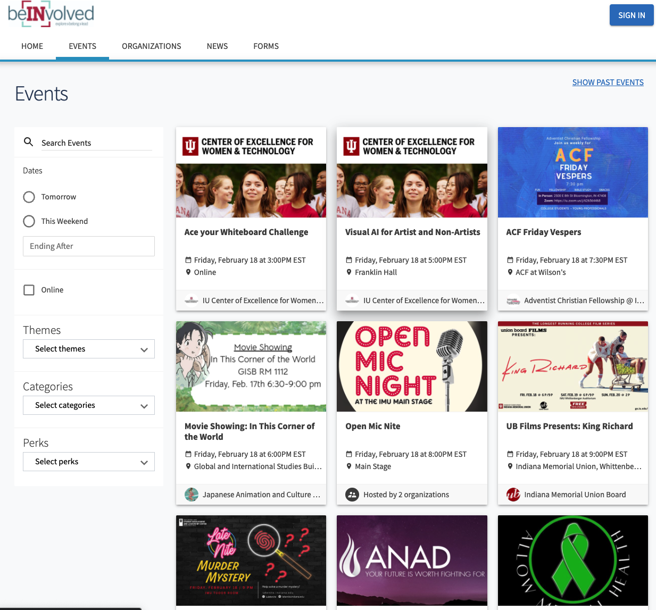
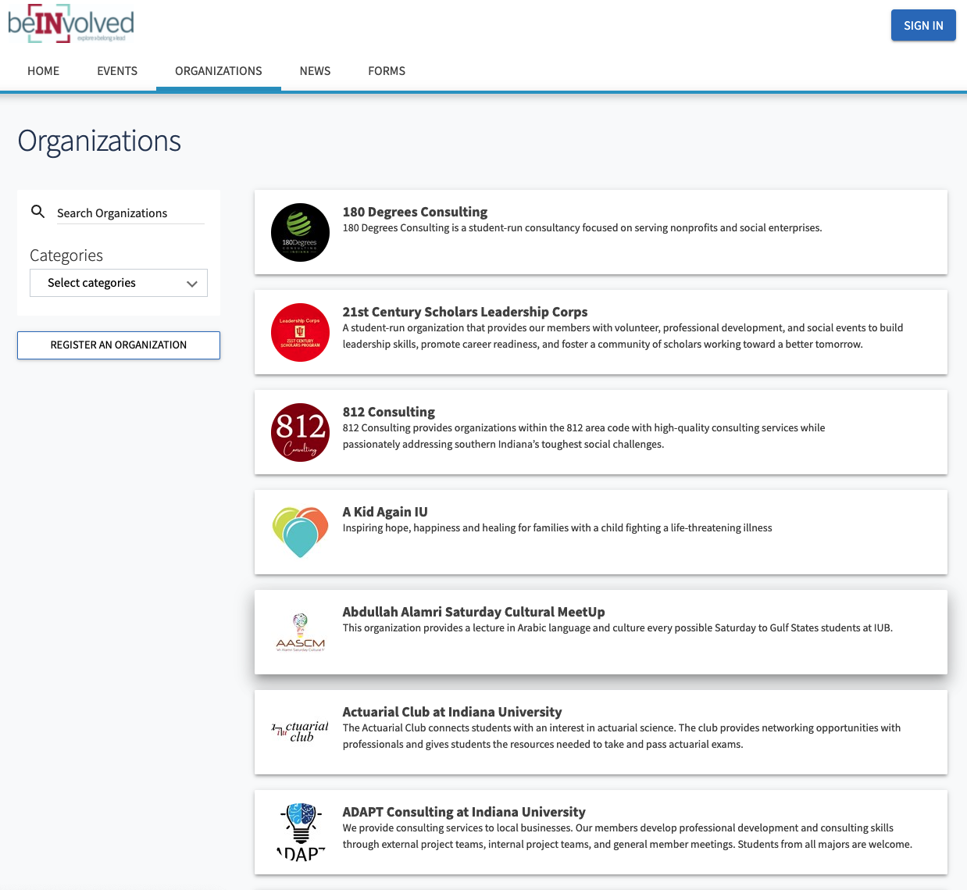

Slide 5

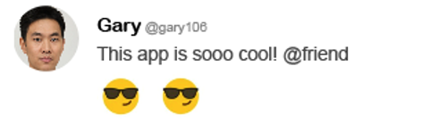
Solution
ConnectIU
“ConnectIU is designed as a mobile app solution to provide IU students with an online interactive platform”
“The app offers two features including a real-time tweet function and a live map to keep track of ongoing activities and relevant IU campus information”

Slide 6
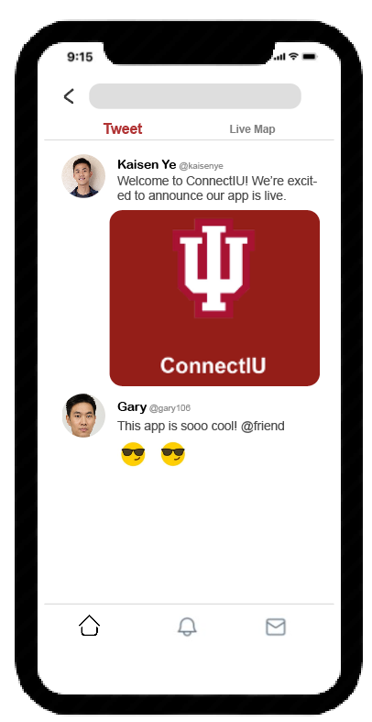
Features
Real-Time Tweet
Keep track of what’s happening and what people are talking about around the IU campus
Publish and promote your organizations and upcoming events
Join the conversation and have an impact on the IU community

Slide 7
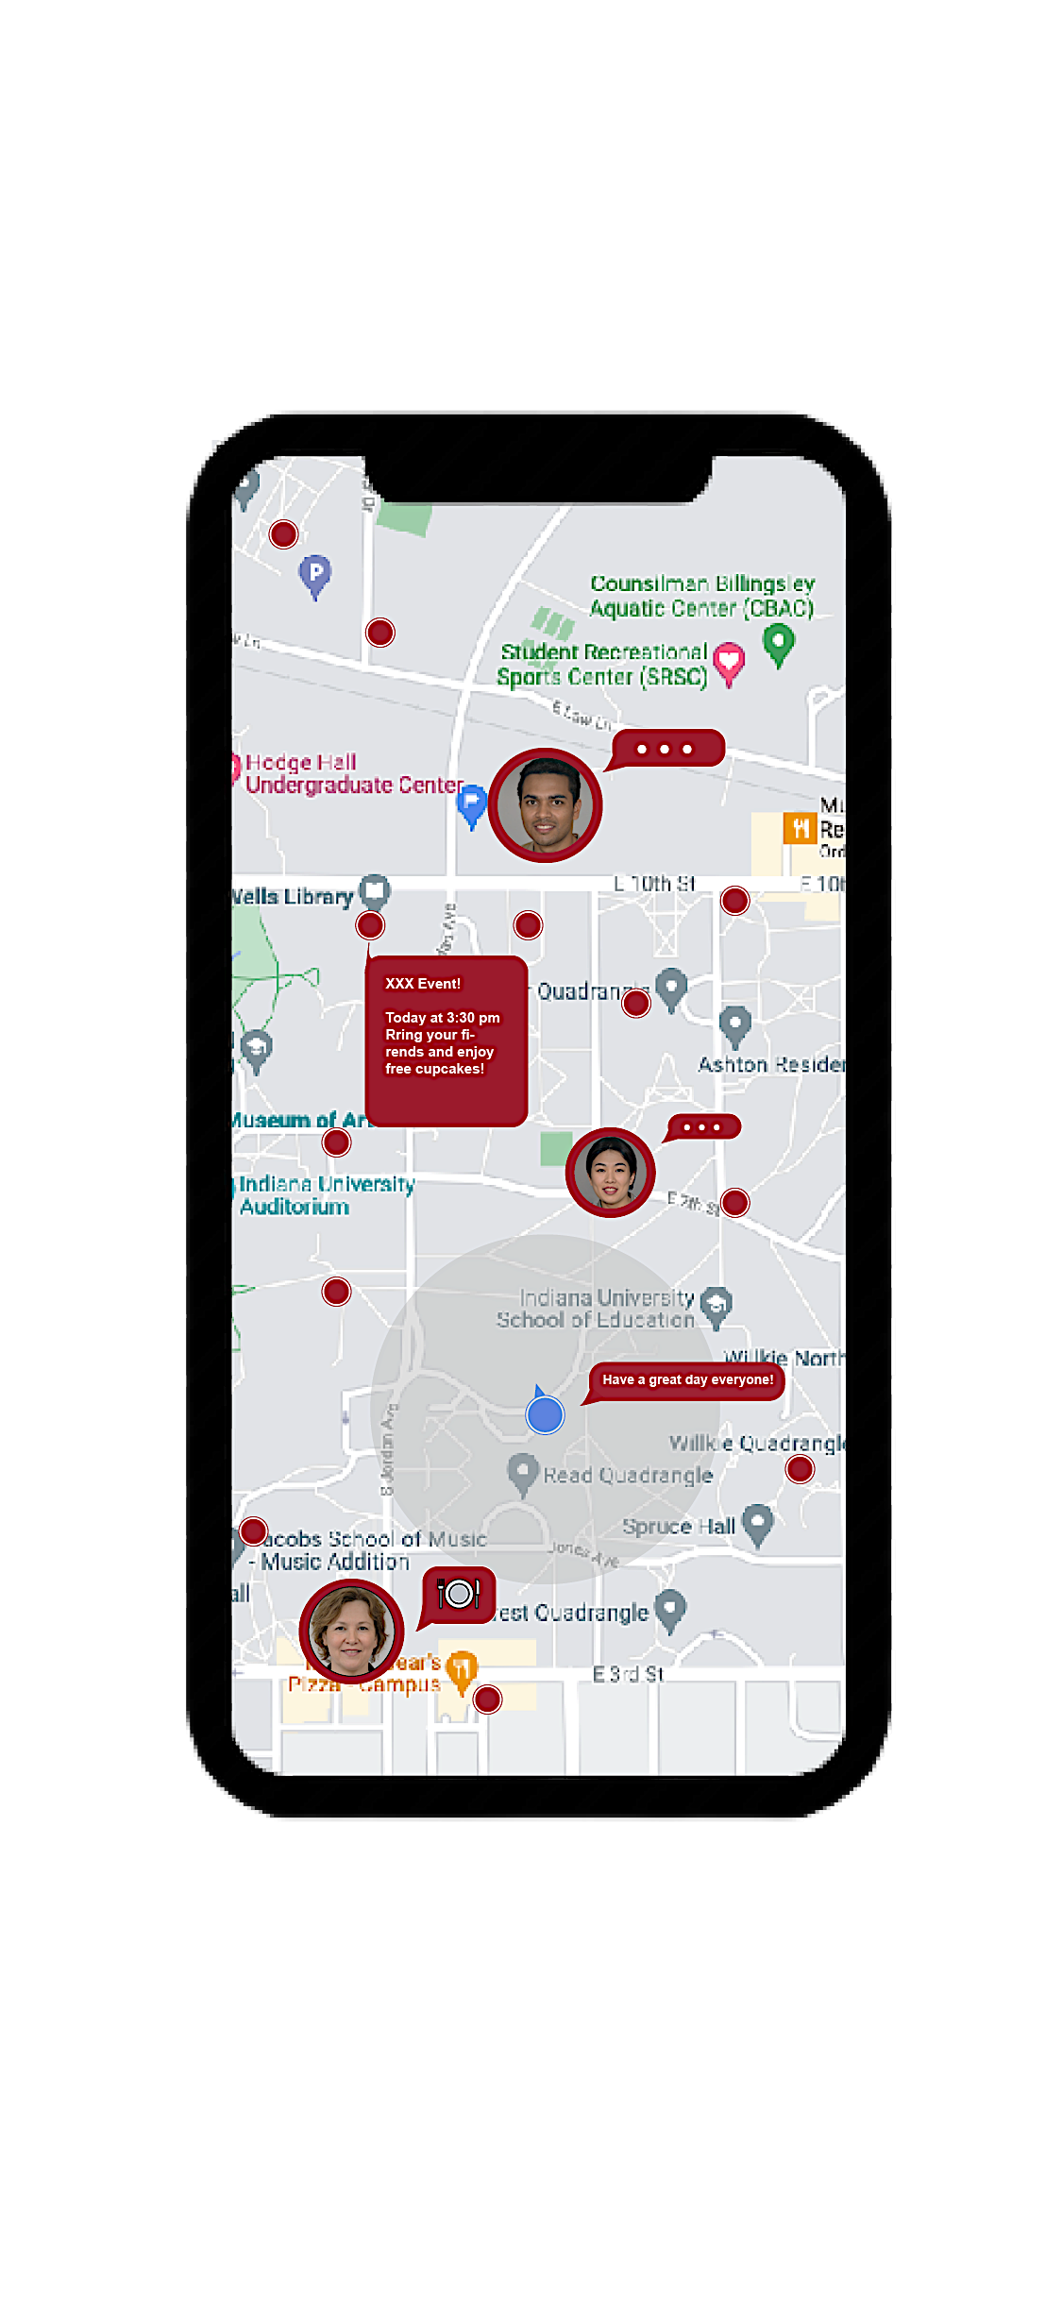




Features
Live Roadmap
Find Quickest Route
Location Sharing
ConnectIU leverages most advanced route planning algorithms to find fastest routes/options traveling around campus
Real-time location sharing with your friends, track their status, activities, and movements
Monitor Activities
Instant Message
With our live roadmap, users can monitor all the ongoing and future events and activities on the IU campus
Simply tap on user’s profile icon,
send messages, pictures, and files anytime, anywhere

Slide 8
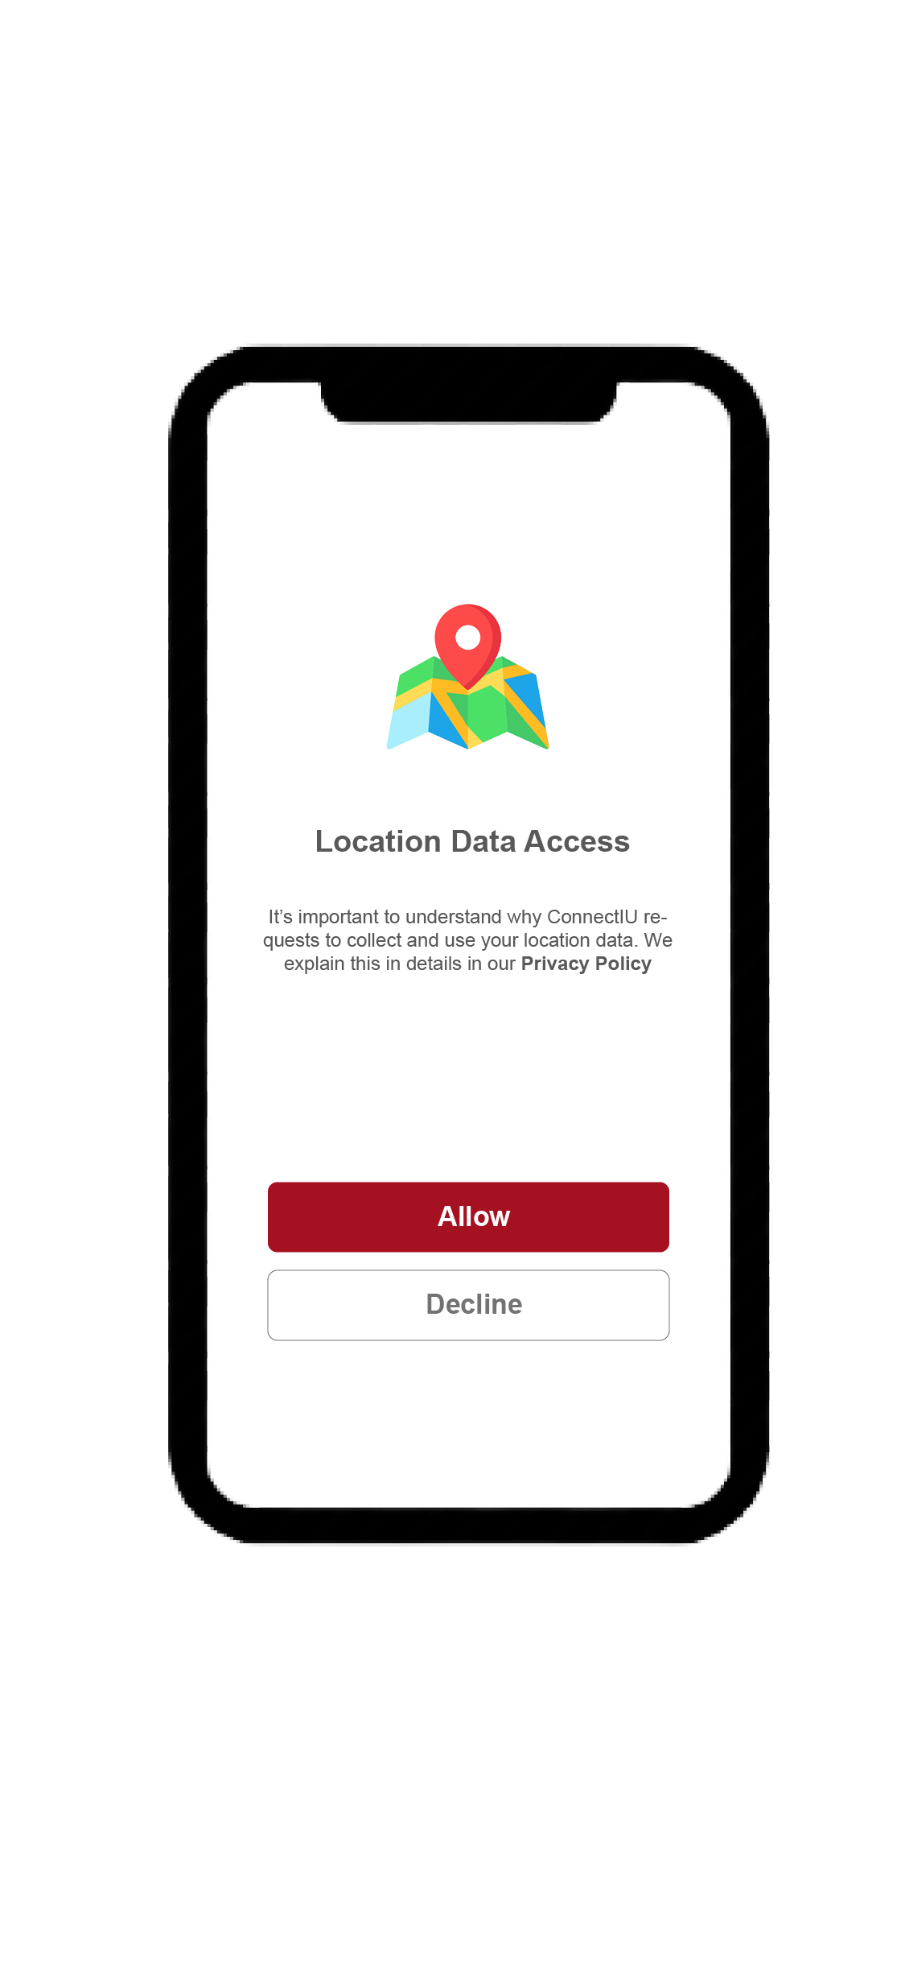
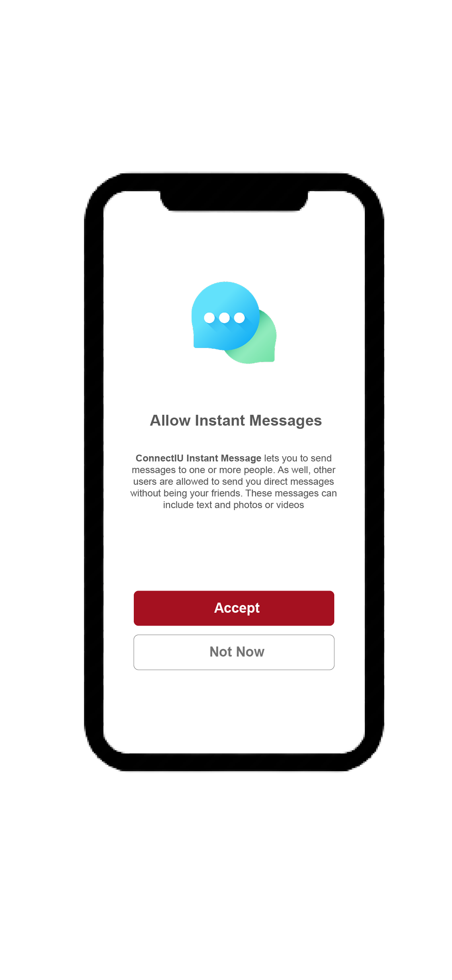
Security
User Privacy
Minimize
personal information and data requests
Maximize
value of contents and user interaction

Slide 9
Target Users & Market
IU Faculties
Body Count
IU Students
Body Count
21,000+
90,000+

Slide 10
Project Timeline
Finalize UI/UX Design on Adobe XD
Architecture & Database Design
Feb - 2022
May - 2022
Summer - 2022
April - 2022
June - 2022
Brainstorming & Project Planning
Design Markups & User Surveys
App Development
(Web, iOS, Android)

Slide 11
Thank You
Let us bring IU community back together

